Slide 1
Department of Political Science
SHUBHARAJ P. BUWA
ASSOCIATE PROFESSOR

Slide 2
Three year integrated undergraduate degree course
6 Semesters - 12 Papers
(100 + 100) + (200 + 200) + (300 +300) = 1200 marks
250 internal marks - 950 marks - semester end examination
187 students - ONE TEACHER
21 Hours of teaching per week

Slide 3
Semesters and Papers
Semester no. | Paper no. | Paper title | Internal marks/Passing marks | Semester end exam. Marks/Passing marks
1 | 1 | Indian Political System – The Constitution | --- | 100/40
2 | 1 | Indian Political System – The Political Process | --- | 100/40
3 | 2 | Indian Political System – The Constitution | 25/10 | 75/30
3 | 3 | Public Administration | 25/10 | 75/30
4 | 2 | Indian Political System – The Political Process | 25/10 | 75/30
4 | 3 | Indian Administration | 25/10 | 75/30
5 | 4 | Politics of Modern Maharashtra | 25/10 | 75/30
5 | 5 | Western Political Thought | 25/10 | 75/30
5 | 6 | World Politics | 25/10 | 75/30
6 | 4 | Determinants of Politics of Maharashtra | 25/10 | 75/30
6 | 5 | Indian Political Thought | 25/10 | 75/30
6 | 6 | India in World Politics | 25/10 | 75/30

Slide 4
Bachelor of Arts…
One division
Medium of Instruction - English + Marathi
Most of them offer Marathi medium
Choice of subjects available at third year.

Slide 7
What else we do…?
Online Quizzes
Visit to US consulate
Guest Lectures
WhatsApp group
Audio Visual
Moodle Site

Slide 8
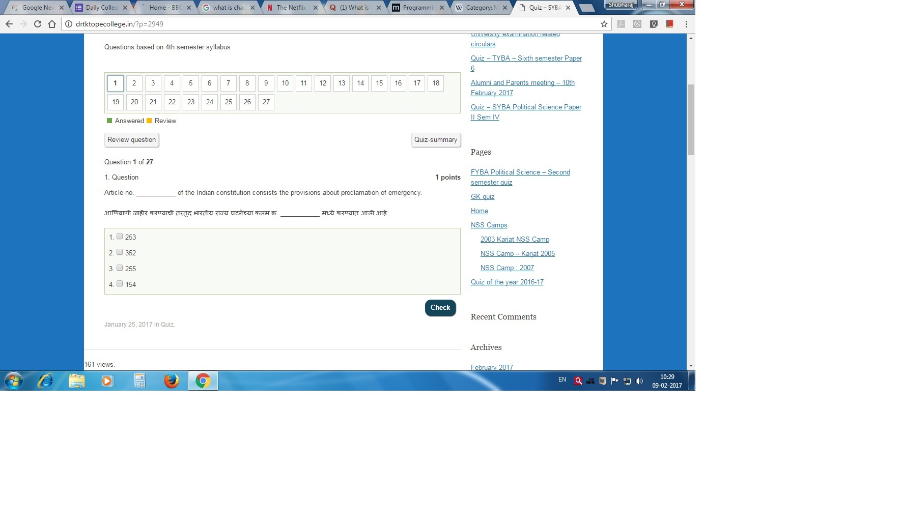
Quiz for SYBA - Screen Shot

Slide 9
Guest Lectures and Visits
Sr no. | Date | Guest | Topic
1 | 7 FEBRUARY 2016 | Virendra Valsangkar | Making Documentaries
2 | 23 FEBRUARY 2016 | Dr. Swati Pitale | Nationalism of Ravindranath Tagore
3 | 24 FEBRUARY 2016 | Prof. Dr. Sanjay Deshpande | India – Russia Relations
4 | 25 FEBRUARY 2016 | Prashant Kelkar (Associate Professor) | The Kashmir Issue from a different perspective
5 | 20 MARCH 2016 | Visit to US consulate | Lecture on India – US relations
6 | 30 AUGUST2016 | Dr. Chaitra Redkar | Simon de Beauvoir

Slide 10
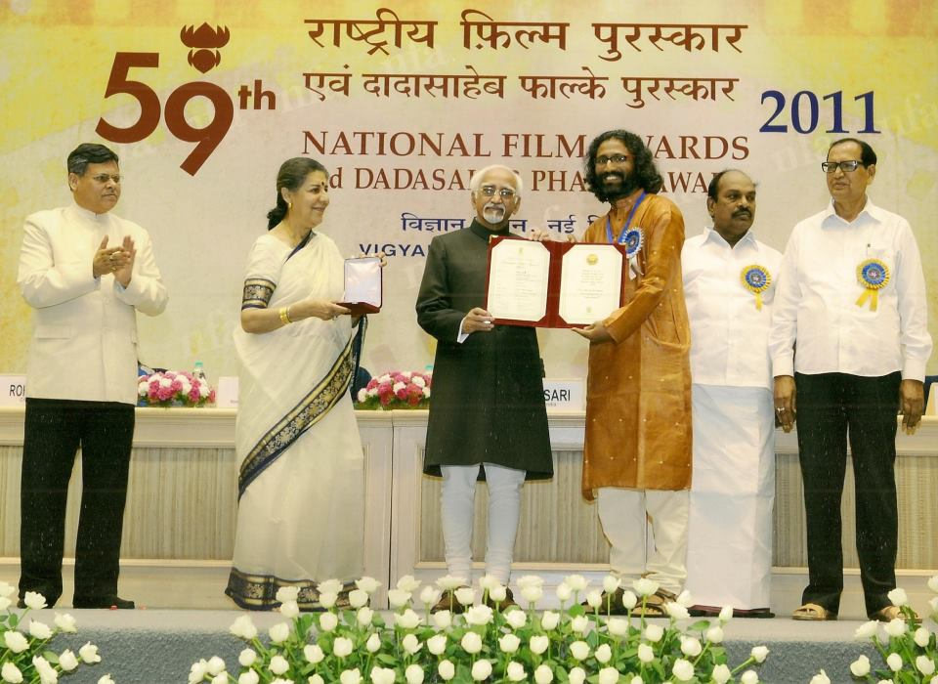
Virendra Valsangkar

Slide 11
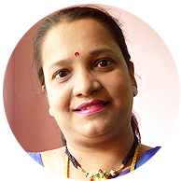
Guest Lectures Dr. Swati Pitale
Nationalism of Ravindranath Tagore
23-2-2016

Slide 12
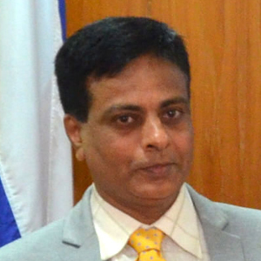
Dr. Sanjay Deshpande
India – Russia Relations
24-2-2016

Slide 13
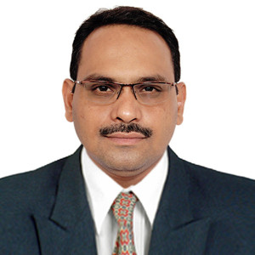
Prashant Kelkar
Lecture on current situation in Jammu and Kashmir
25-2-2016

Slide 14
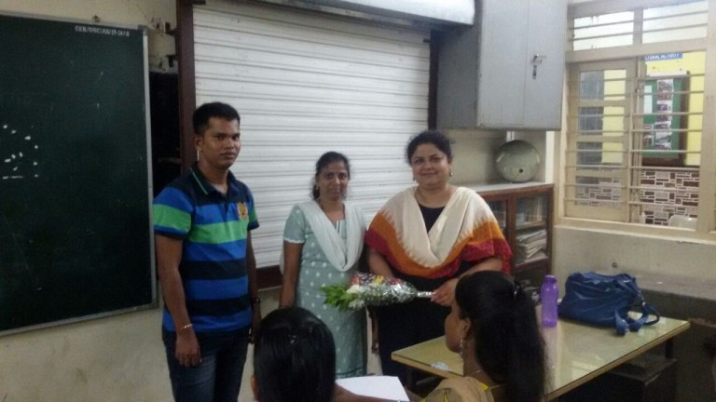
Dr. Chitra Redkar from SNDT University on Simon de Beauvoir 30-8-2016

Slide 15
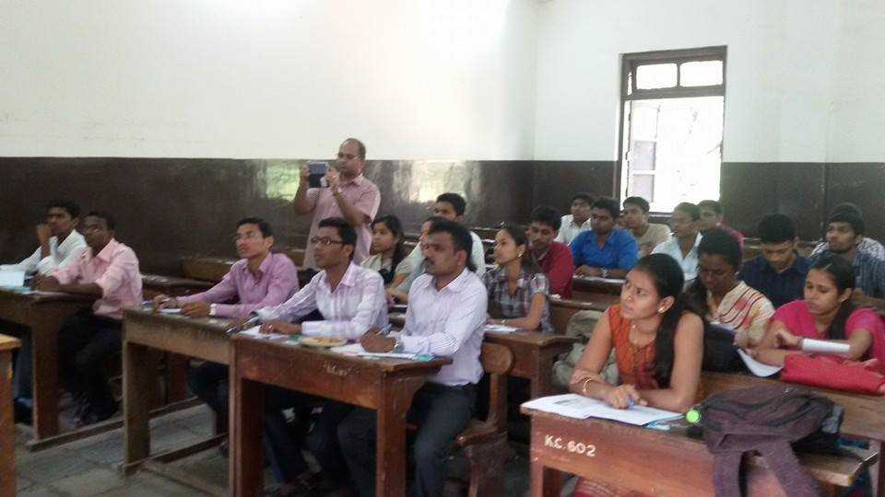
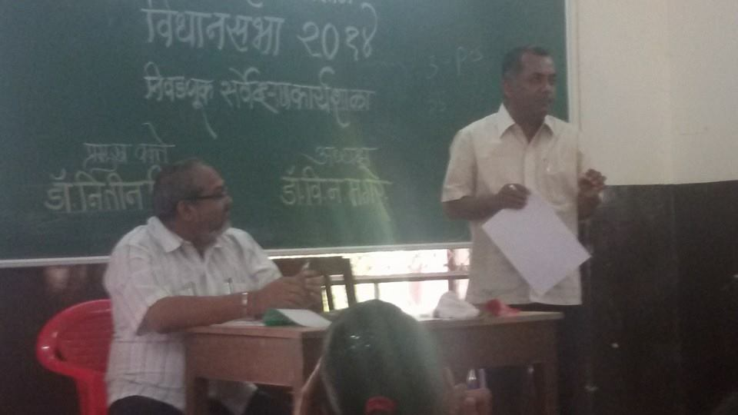
Students participated in the Election workshop organised by Savitribai Phule Pune University, Pune at Kirti College and the actual survey.

Slide 16
About me
Graduate from Shivaji University, Kolhapur
Post Graduation – Savitribai Phule Pune University
Cleared NET and SET examination

Slide 17
Publications…
8 Chapters in 5 different Political Science Text Books
Edited one IDOL book
Translation of a Text book
One more book in the press…

Slide 18
University level work
Paper setter
Assessment
Moderation
Chairmanship of a Paper
Part of syllabus sub- committees
V. C. Nominee and Governing body nominee for selection and promotion interviews

Slide 19
Currently working as an Associate Professor
Ph. D. topic – Transformational Aspects of E-Governance – a case study of certain districts in Maharashtra
Guide – Professor Kannamma Raman, Department of Civics and Politics, University of Mumbai

Slide 20
Membership of professional organisations…
Maharashtra Political Science and Public Administration Conference
(re-elected unanimously as a member of executive committee till 2019)
Indian Political Science Association
International Political Science Association

Slide 21
Participation in College activities
Chairman of
Sports department
Attendance committee
Time Table committee
Examination committee
Discipline committee
NSS Programme Officer for 7 years (2001-02 to 2007-08)
Member of
Examination Committee
Nishigandh Editorial Board

Slide 22
Software development…
MS Excel sheet for Salary and Form 16 of all employees.
From 2001 to 2010 – Result programme in MS Access.
NSS database.
Currently Online result declaration module in PHP + MySQL + HTML
Useful for students as well as office staff.

